Slide 1
Hot air balloon
A hot air balloon has a powerful heater.
The heater heats the air inside the balloon.

Slide 2
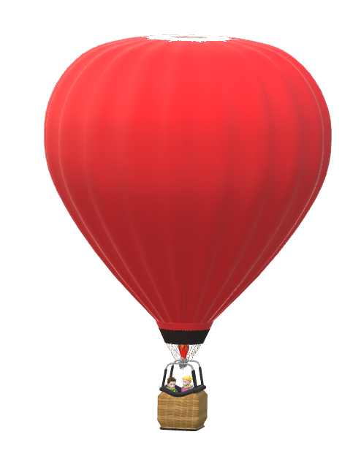
Hot air balloon
These statements are about why warm air makes the balloon float.
What do you think about each statement?
I am sure this is right
I think this is right
I think this is wrong
I am sure this is wrong
A
Air particles are bigger when they are hotter.
B
Air particles weigh less when they are hotter.
C
Warm air is less dense than cooler air.
D
There are fewer air particles in a warmer balloon than in a cooler one.

